Slide 1
BBM 102 – Introduction to Programming II Spring 2019
Abstract Classes and Interfaces

Slide 2
Today
Abstract Classes
Abstract methods
Polymorphism with abstract classes
Example project: Payroll System
Interfaces
What is an Interface?
Defining an Interface
Implementing an Interface
Implementing Multiple Interfaces
Extending a Class and Implementing Interface(s)
Extending an Interface
Interfaces as Types
Interfaces vs Abstract Classes

Slide 3
Abstract Classes
An abstract class is a class that is declared abstract
An abstract class may or may not include abstract methods.
Abstract classes cannot be instantiated, but they can be subclassed.

Slide 4
Abstract Classes: Revisiting the Shapes
Shape
Abstract Class
Circle
Quadrilateral
Triangle
Square
Rectangle

Slide 5
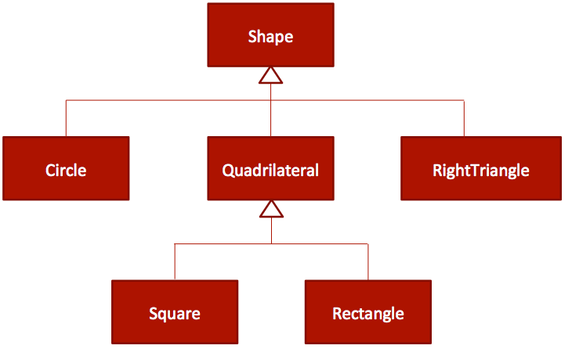
Abstract Classes
All shapes have certain attributes (e.g.: position, orientation, line color, fill color) and behaviors (e.g.: moveTo, rotate, resize, draw) in common.
Some of these attributes and behaviors are the same for all shapes (e.g. : position, fill color, and moveTo).
Others require different implementations (e.g., resize or draw).
All shapes must be able to draw or resize themselves; they just differ in how they do it.

Slide 6
Abstract Classes
public class Shape {
private String name;
public Shape(String name) {
this.name = name;
}
public String getName() {
return name;
}
public void draw() {
// what is the shape?
// Code...?! Nothing!
}
}
public abstract class Shape {
private String name;
public Shape(String name) {
this.name = name;
}
public String getName() {
return name;
}
public abstract void draw();
// sub-classes will define it
}

Slide 7
Abstract Methods
An abstract method is a method that is declared without an implementation
without braces, and followed by a semicolon, like this: public abstract void draw();
When an abstract class is subclassed, the subclass should provide implementations for all of the abstract methods in its parent class.
However, if they do not, then those subclasses must also be declared abstract.

Slide 8
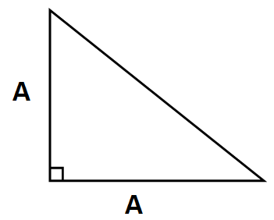

Abstract Classes
public class RightTriangle extends Shape {
private int a;
public RightTriangle(String name, int a) {
super(name);
this.a = a;
}
public int getA() {
return a;
}
// override abstract method
public void draw() {
for (int line = 1; line <= a; line++) {
for (int i = 0; i < line; i++) {
System.out.print("*");
}
System.out.println();
}
}
}

Slide 9
Abstract Classes
public abstract class Quadrilateral
extends Shape {
public Quadrilateral(String name) {
super(name);
}
// still nothing to draw!
public abstract void draw();
}
public class Square extends Quadrilateral {
private int a;
public Square(String name, int a) {
super(name);
this.a = a;
}
public int getA() {
return a;
}
// override abstract method
public void draw() {
for (int line = 0; line < a; line++) {
for (int col = 0; col < a; col++) {
System.out.print("*");
}
System.out.println();
}
}
}

Slide 10
Abstract Classes
public class Program {
public static void main(String[] args) {
// compilation error!: "Cannot instantiate the type Shape"
Shape shape = new Shape("Shape");
// compilation error!: "Cannot instantiate the type Quadrilateral"
Quadrilateral quadrilateral = new Quadrilateral("Quadrilateral");
Square s = new Square("Square", 4);
s.draw();
Rectangle r = new Rectangle("Rectangle", 3, 7);
r.draw();
RightTriangle t = new RightTriangle("RightTriangle", 5);
t.draw();
}
}

Slide 11
Abstract Classes
Are part of the inheritance hierarchy
Circle extends Shape
Square extends Quadrilateral
Can have constructor(s), but no objects of these classes can be created
Shape shape = new Shape("Shape");
// compilation error!: "Cannot instantiate the type Shape“
Classes that can be used to instantiate objects are called concrete classes.

Slide 12
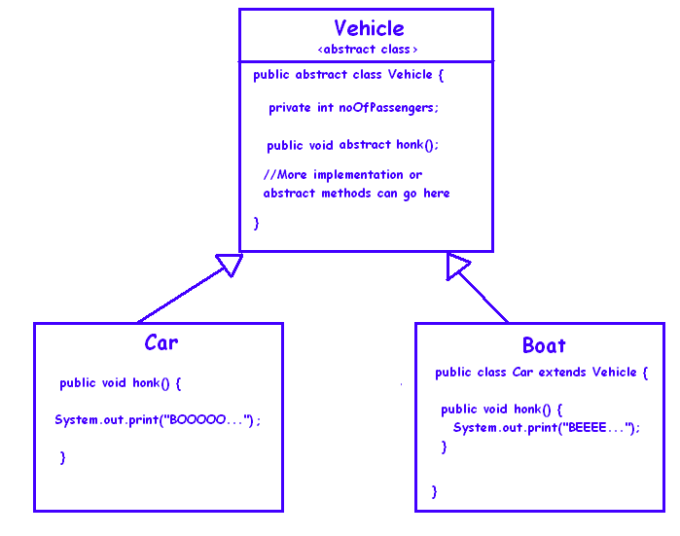
Example-1

Slide 13
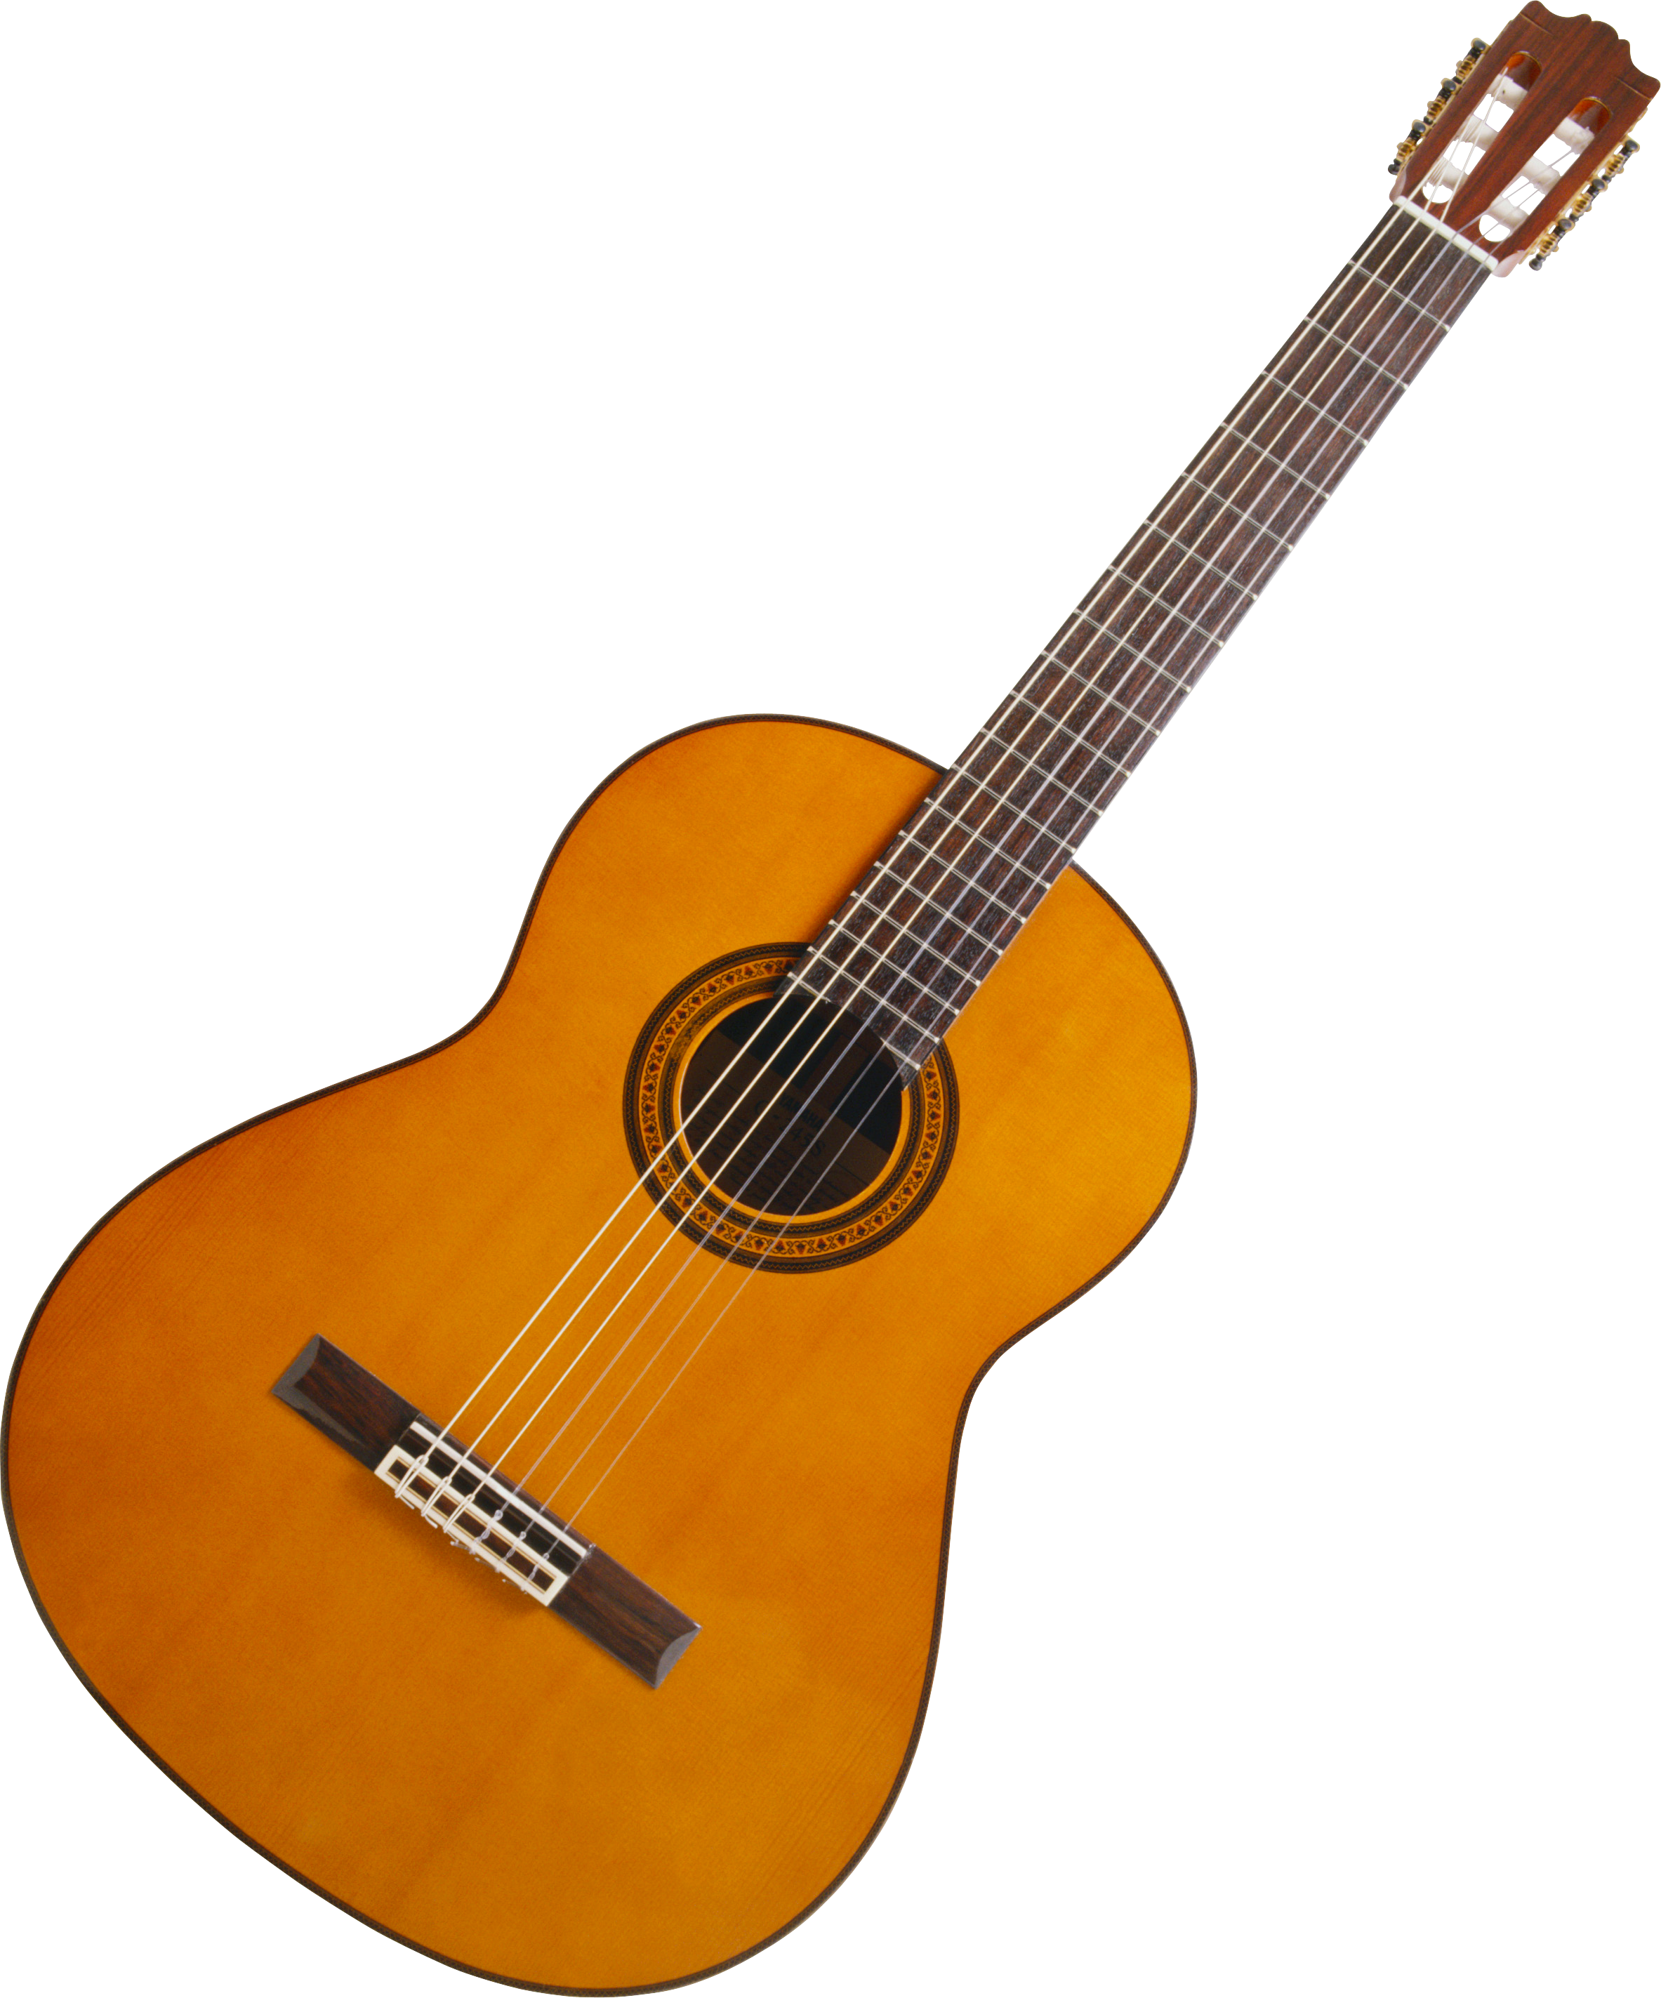
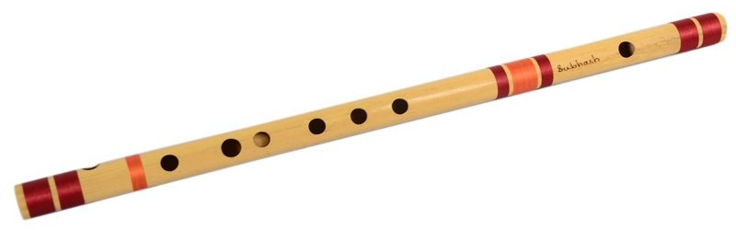
Example-2: music instruments
Imagine there are several instruments, either stringed or wind.
Design a class hierarchy for only two types of instruments, guitars and flutes.
You have to design your model in a way that new instruments can be added in the hierarchy later on.
Imagine there is only one feature for each instrument at the moment, which is the play feature.

Slide 14
Example-2: music instruments
Instrument
StringedInstrument
WindInstrument
Guitar
Flute

Slide 15
Example-2: music instruments
Abstract class
public abstract class Instrument {
private String name;
abstract public void play();
}
Still abstract
abstract public class StringedInstrument extends Instrument {
private int numberOfStrings;
}
public class Guitar extends StringedInstrument{
public void play(){
System.out.println(“Guitar is rocking!”);
}
}

Slide 16
Example-2: music instruments
public abstract class WindInstrument extends Instrument {
//features
}
public class Flute extends WindInstrument{
public void play(){
System.out.println(“Flute is rocking!”);
}
}

Slide 17
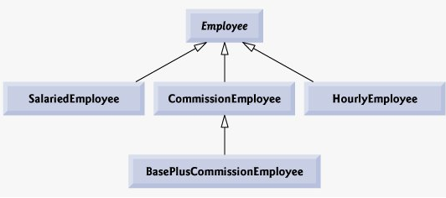
Example Project: Payroll System

Slide 18
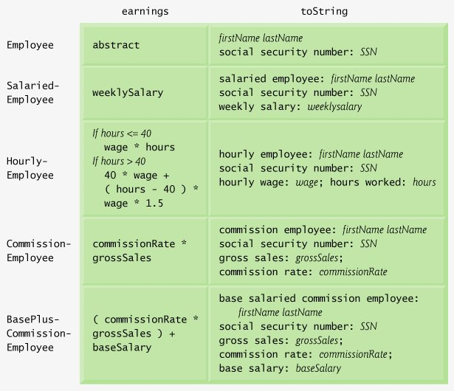
Overview of the classes

Slide 19
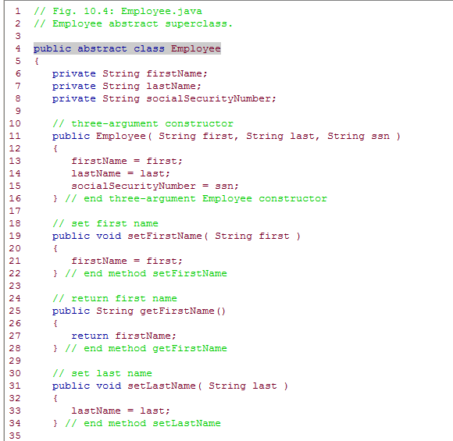
Employee.java (1)

Slide 20
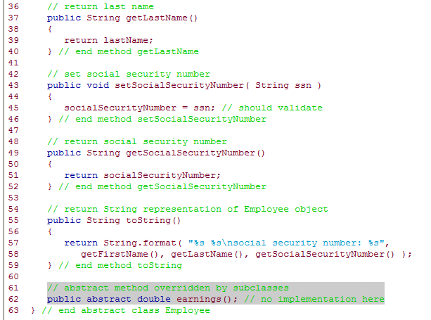
Employee.java (2)
Earnings will be calculated in subclasses

Slide 21
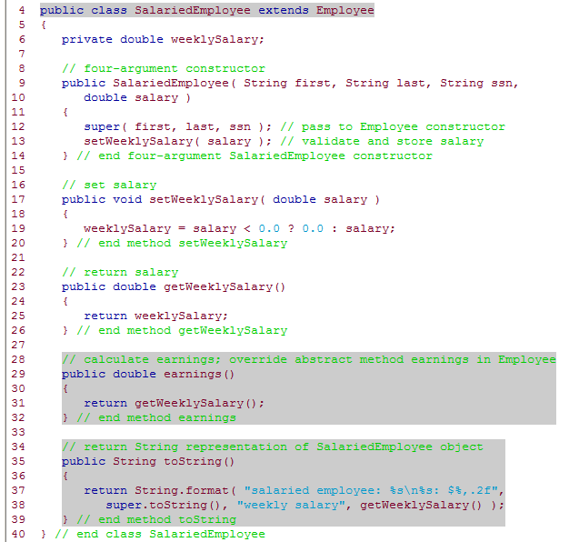
SalariedEmployee.java
Overridden methods

Slide 22
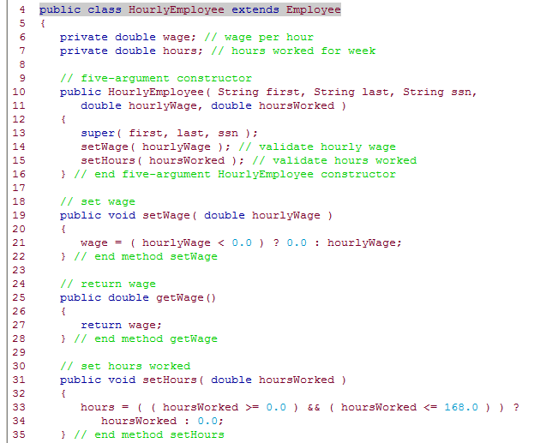
HourlyEmployee.java (1)

Slide 23
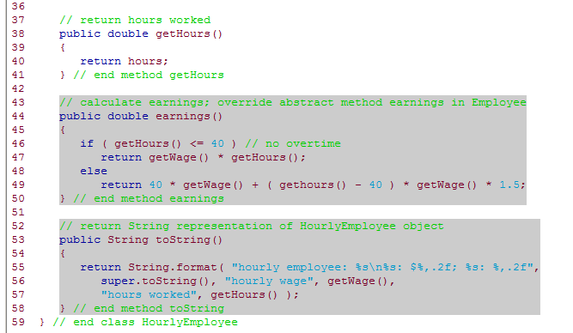
HourlyEmployee.java (2)

Slide 24
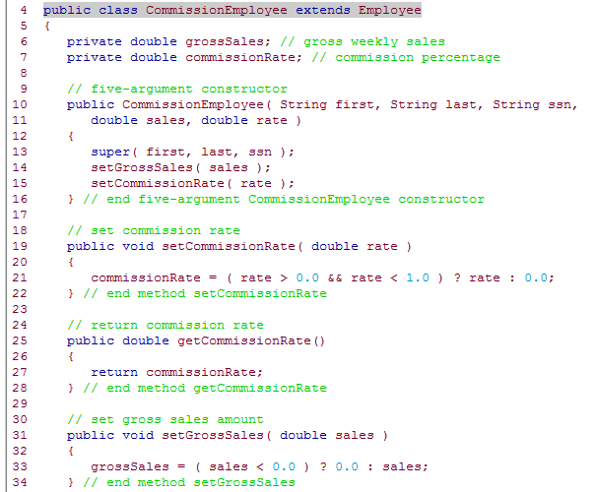
CommissionEmployee.java (1)

Slide 25
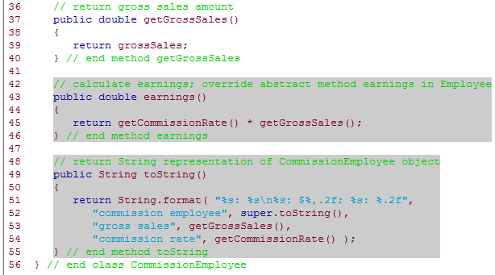
CommissionEmployee.java (2)

Slide 26
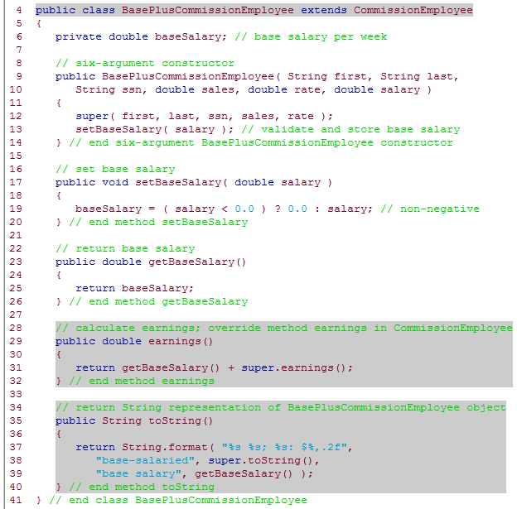
BasePlusCommissionEmployee.java

Slide 27
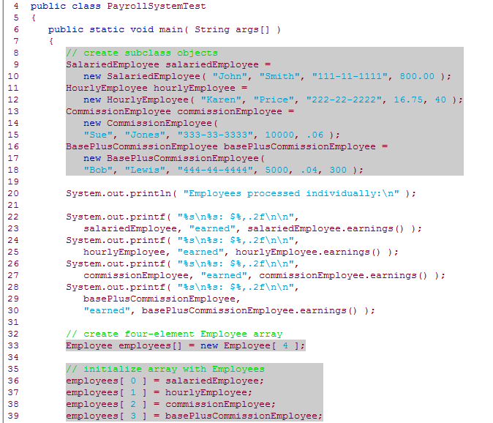
PayrollSystemTest.java (1)

Slide 28
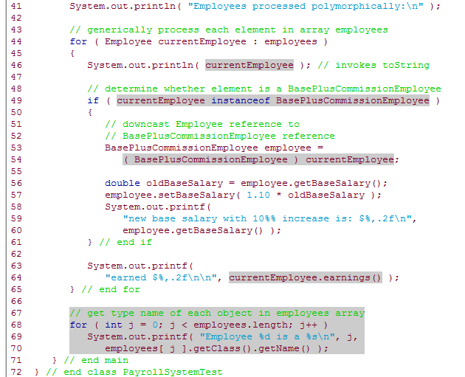
PayrollSystemTest.java (2)

Slide 29
Today
Abstract Classes
Abstract methods
Polymorphism with abstract classes
Example project: Payroll System
Interfaces
What is an Interface?
Defining an Interface
Implementing an Interface
Implementing Multiple Interfaces
Extending a Class and Implementing Interface(s)
Extending an Interface
Interfaces as Types
Interfaces vs Abstract Classes

Slide 30
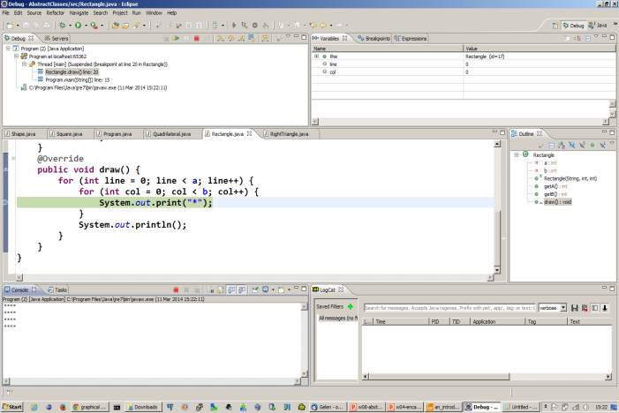
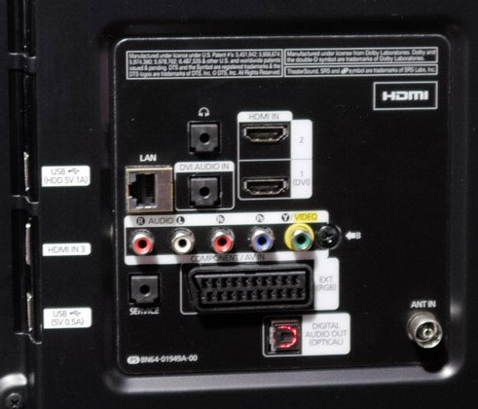
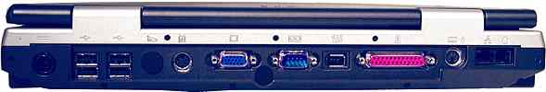
Interfaces
GUI
LCD/LED TV
Laptop

Slide 31
Concept of Interface
An interface is a contract. It guarantees that the system will have certain functionalities.
An interface is an integration point between two systems.
A system can have many interfaces, so it can be integrated to many other systems.

Slide 32
Defining an Interface in Java
Keyword interface is used to define an interface
Methods in an interface must be public and abstract, these keywords are commonly omitted
Interfaces can include public static final variables (constants), these keywords are commonly omitted
public interface Shape {
public abstract void draw();
public static final double PI = 3.14;
}
No need to write

Slide 33
Implementing an Interface
An interface is implemented by the keyword implements
Any class implementing an interface must either implement all methods of it, or be declared abstract
public class RightTriangle implements Shape {
// .....
public void draw() {
for (int line = 1; line <= a; line++) {
for (int i = 0; i < line; i++) {
System.out.print("*");
}
System.out.println();
}
}
}

Slide 34
Implementing Multiple Interfaces
More than one interface can be implemented by a class.
Names of interfaces are separated by comma
public class LedTv implements Usb, Hdmi, Vga {
// .....
}

Slide 35
Extending a Class and Implementing Interface(s)
public class Car extends Vehicle
implements Shape {
public void draw() {
// ....
}
}

Slide 36
Extending an Interface
It is possible for an interface to extend another interface
public interface I1 {
void m1();
}
public interface I2 extends I1 {
void m2();
}
public class C1 implements I1 {
public void m1() {
// ...
}
}
public class C2 implements I2 {
public void m1() {
// ...
}
public void m2() {
// ...
}
}

Slide 37
Interfaces as Types
When you define a new interface, you are defining a new reference data type.
You can use interface names anywhere you can use any other data type name.
If you define a reference variable whose type is an interface, any object you assign to it must be an instance of a class that implements the interface.

Slide 38
Interfaces as Types
public class Program {
public static void main(String[] args) {
Shape shape;
shape = new Square(4);
shape.draw();
shape = new Rectangle(3, 7);
shape.draw();
shape = new RightTriangle(5);
shape.draw();
}
}
public class Program {
public static void main(String[] args) {
Shape[] shapes = new Shape[3];
shapes[0] = new Square(5);
shapes[1] = new Rectangle(2, 8);
shapes[2] = new RightTriangle(3);
for (Shape s : shapes) {
drawIt(s);
}
}
public static void drawIt(Shape s) {
s.draw();
}
}

Slide 39
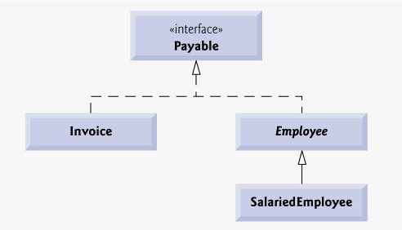
Example Project: Payroll System Revisited
Interface implementation symbol

Slide 40
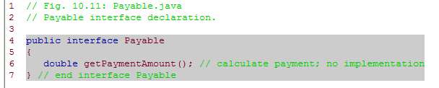
Payable.java

Slide 41
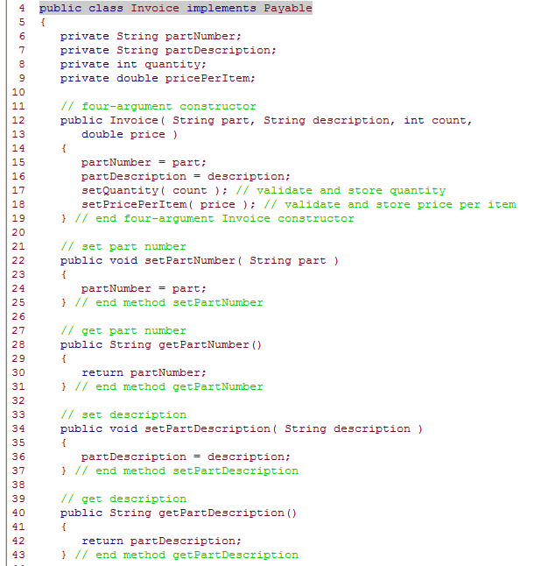
Invoice.java (1)

Slide 42
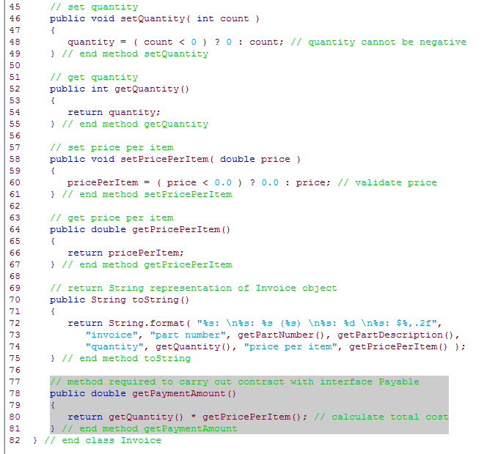
Invoice.java (2)

Slide 43
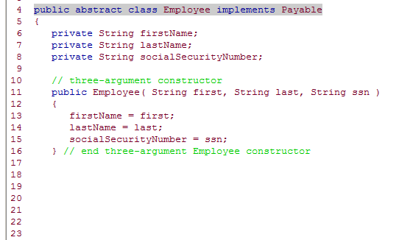
Employee.java
Payable interface includes getPaymentAmount() method, but class Employee does not implement it!
/* Rest of the class is same as the previous example except there is no earnings() method! */

Slide 44
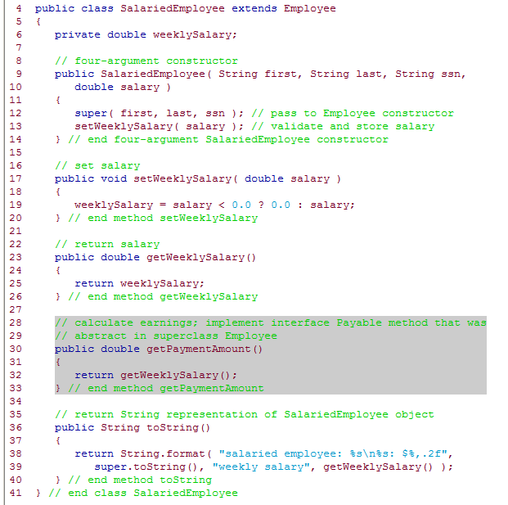
SalariedEmployee.java

Slide 45
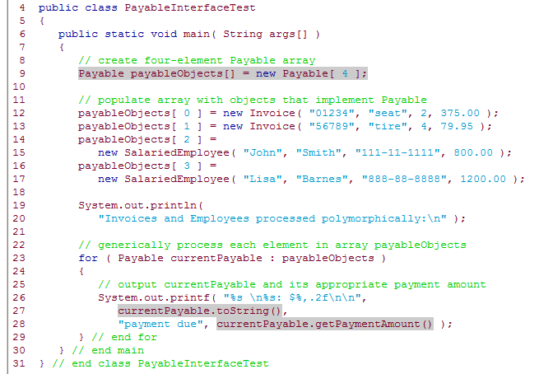
PayableInterfaceTest.java

Slide 46
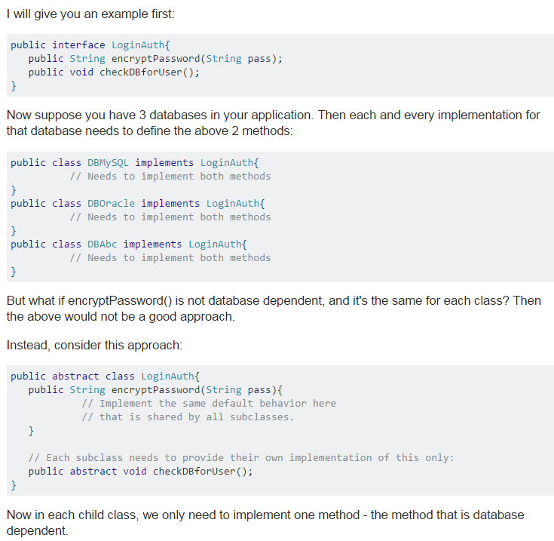
Interfaces vs. Abstract Classes

Slide 47
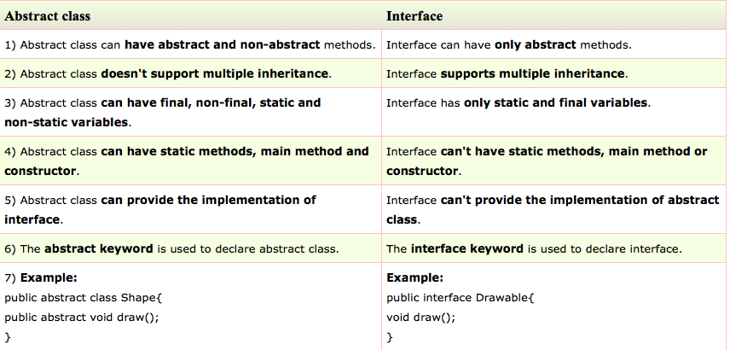
Interfaces vs Abstract Classes

Slide 48
Summary
Abstract class is defined with the keyword abstract
If a class includes an abstract method, it must be declared as abstract
Objects of abstract classes cannot be created
Interface is defined with the keyword interface
A class can implement an interface, an interface can extend an interface
A class can implement many interfaces
Objects of interfaces cannot be created

Slide 49
Acknowledgements
The course material used to prepare this presentation is mostly taken/adopted from the list below:
Java - How to Program, Paul Deitel and Harvey Deitel, Prentice Hall, 2012
http://www.javatpoint.com/difference-between-abstract-class-and-interface

